Slide 1
Danger Of Fires
WildFires caused
by the weather

Slide 2
TimeLine:
Preliminary Information
Research Question
Data Acquisition
Data Cleaning
Visualization and EDA
Machine Learning

Slide 3


Preliminary Information About Fires in USA
Within the next two decades, temperatures will rise 1.5 degrees Celsius.
The last 7 years have been the warmest on record.
A warming world also increases the intensity of natural disasters, especially wildfires.
Humans cause 60-70% of the wildfires.
Average of 62k wildfires per year
Average of 30k km² burned per year
Average annual cost of $1.6B
Average annual death toll of 3,500 humans

Slide 4

Research Questions:
Is it possible to predict what is the main cause of a wildfire?

Slide 5

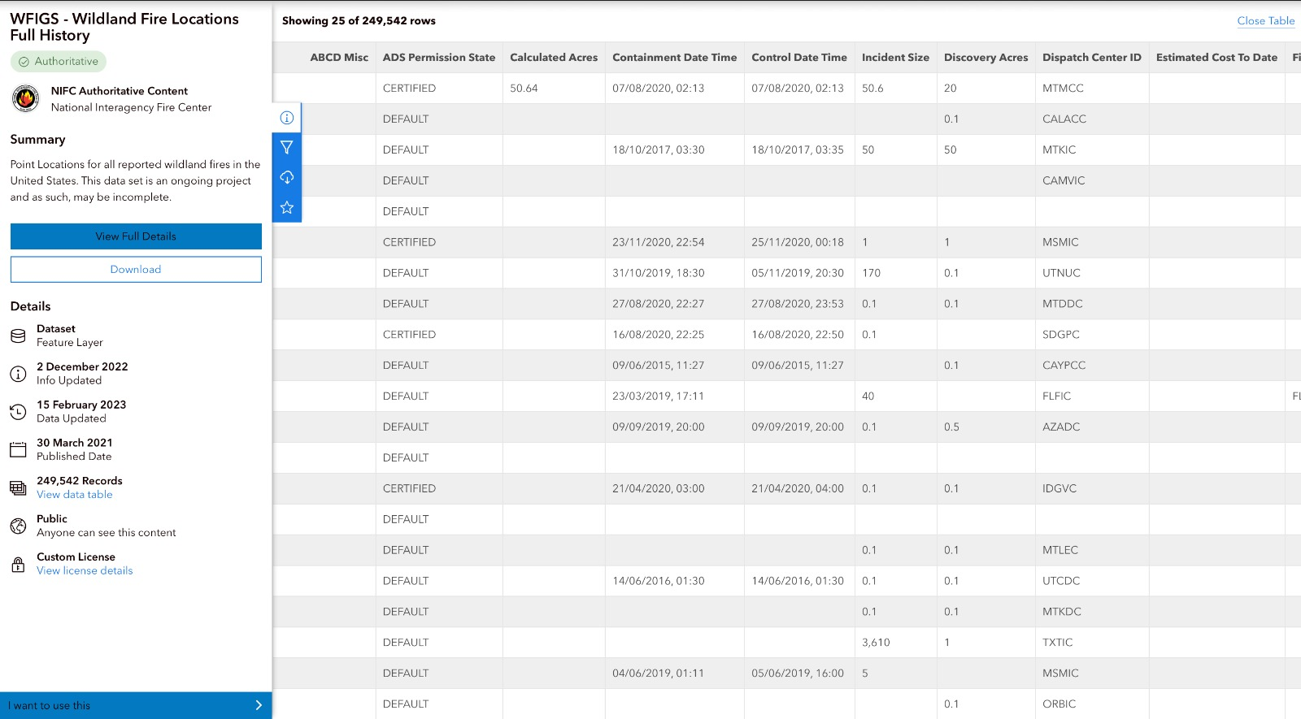
Data Acquisition:
WildFires Data - Crawling
The website we used for the crawling is the National Interagency Fire Center.
In this site we have almost 250,000 wildfires that accure in USA, the data is provided by a table that only shows 25 fires at a time, so we had to find a way to get to all of the fires in the table.
We used Selenium to swipe down slowly and Firefox webdriver to save the entire HTML content.
BeautifulSoup to crawl all the data in the end, and make it a CSV file so we can continue to the Data Cleaning Phase.

Slide 6

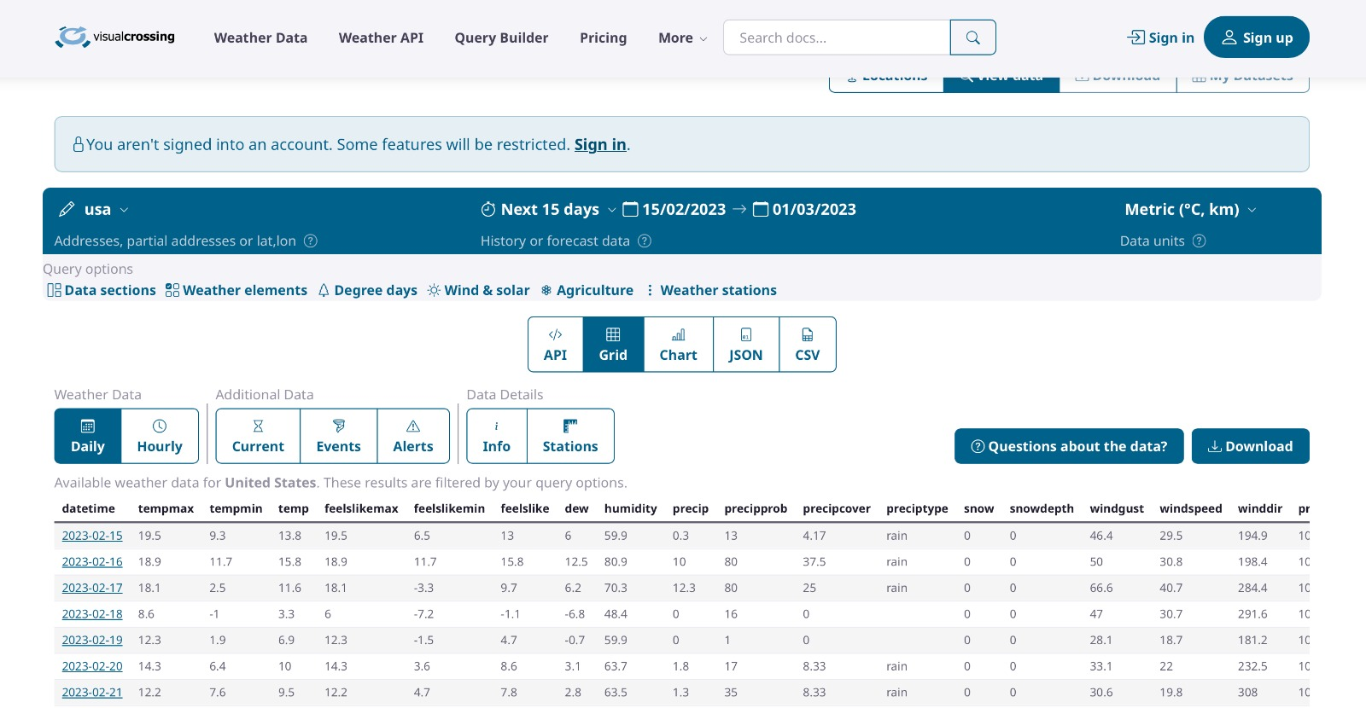
Data Acquisition:
WildFires Data – Weather Data
After we had the CSV file with all the fires data, we need the weather data to create a new CSV with the fires and the weather of each fire.
we tried many weather websites to get a free weather API but we couldn’t find any, so we decided to use: “visual crossing” website
That gives us 1000 rows of weather data per day.
We downloaded the data 1000 rows at a time until we got enough days to include all the fire dates.

Slide 7


Data Cleaning process:
In this phase we cleaned our WildFire CSV so he will be ready for the merge with the weather data.
1. We kept only the relevant cols(from 96 cols to 11)
2. We removed every row that as a NAN value.
3. We handled the outliers latitude and longtitude columns.
4. We converted out DiscoveryDatetime to another format so we could get the weather data by date.
5. We converted the FireCaues columns from string to categoric column.
6. We added a new binary col called “CausedByWeather”
So 1 is a fire from nature and 0 is human or undetermined.

Slide 8


Data Cleaning process:
In this phase we cleaned our MergeData CSV so he will be ready for the Visualization and the machine learning.
1.We merged between the 2 CSV by date and we took the relevant cols to a new merged CSV
2. We handled all Nan Values.
3. We also checked manually the new CSV to see if there is a problem with the weather data in the rows.

Slide 9
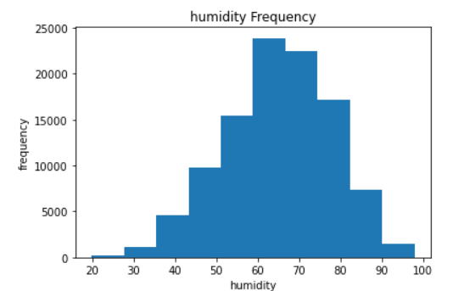
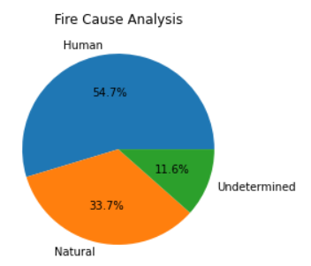
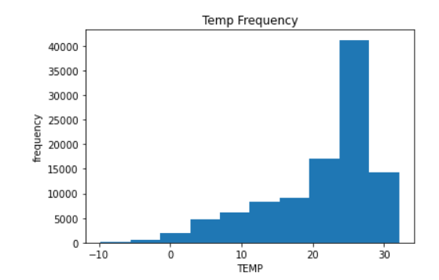
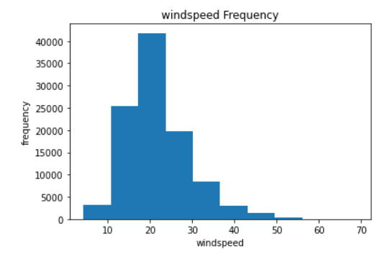
EDA - Exploratory Data Analysis:
Humidity frequency:
The pie chart: shows the percentage of every fire cause
Temp frequency:
Windspeed frequency:

Slide 10
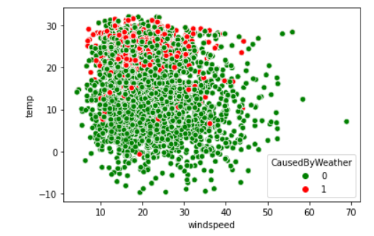
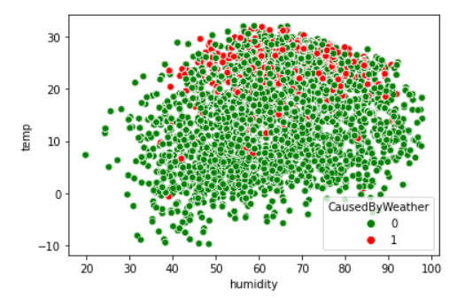
EDA - Exploratory Data Analysis:
This graph represents connection between temp and windspeed, and we can see when the temp is higher and windspeed is lower, there is more chance for the fire to be caused by the weather(1, red)
This graph represents connection between temp and humidity, we can see that when the temp and humidity are bigger, there is more chance for the fire to be caused by the weather(1, red)

Slide 11
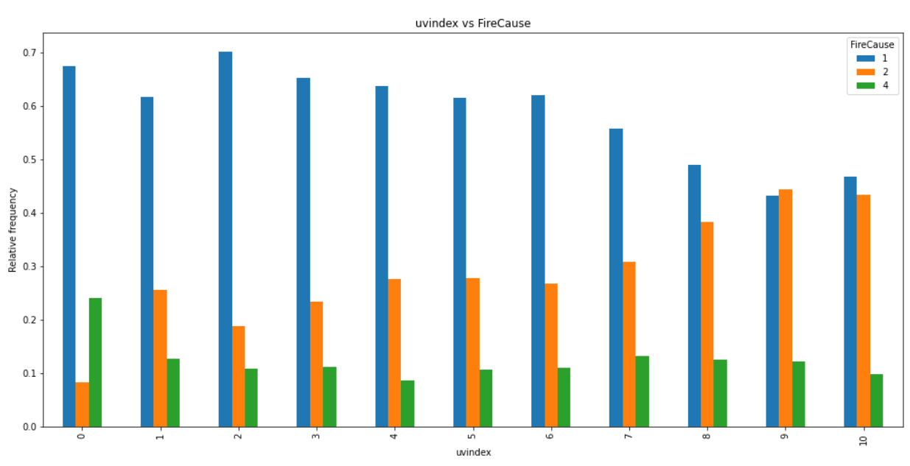
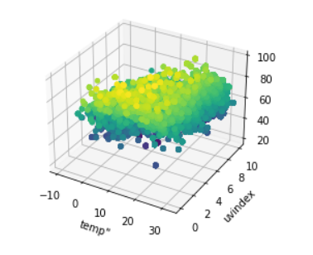
EDA - Exploratory Data Analysis:
The third-dimenstional graph, represents the connection between (temp, uvindex and humidity) the 3 main factors of a fire by weather
This bar represents how the uvindex increase, increases the chances of fires by weather(2,orange)

Slide 12


Machine Learning
The type of machine learning we will use is Supervised Learning.
The label type is Classification Problems.
The Algorithm we will use to predict our findings is Logistic Regression.

Slide 13

Machine Learning
Logistic Regression is a machine learning algorithm that is commonly used for binary classification tasks. It models the probability of a binary response variable (in this case 0/1 as a function of one or more predictor variables
1 fire Cause by weather.
0 fire Cause by Human or Undetermined.
Logistic Regression Machine Learning gave us a 73% accuracy for Predicting the cause of the Wildfire.

Slide 14

Conclustion
After all our research on the subject of fires we realized that there is a deep connection between the effect of weather on the cause of the fire and we were able to speculate with the help of machine learning what the cause of the Wildfire.

Slide 15

Sources Of Information

Slide 16




For any questions, please contact us
Omer Peled
050-8334100
opeled6@gmail.com
Chen Skanderany
052-6262383
chensk22@gmail.com

